Slide 1
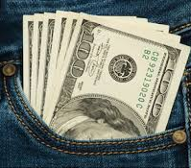
Pocket Money
The money monitoring app for the modern traveler
2020-Team Ivysaur

Slide 2
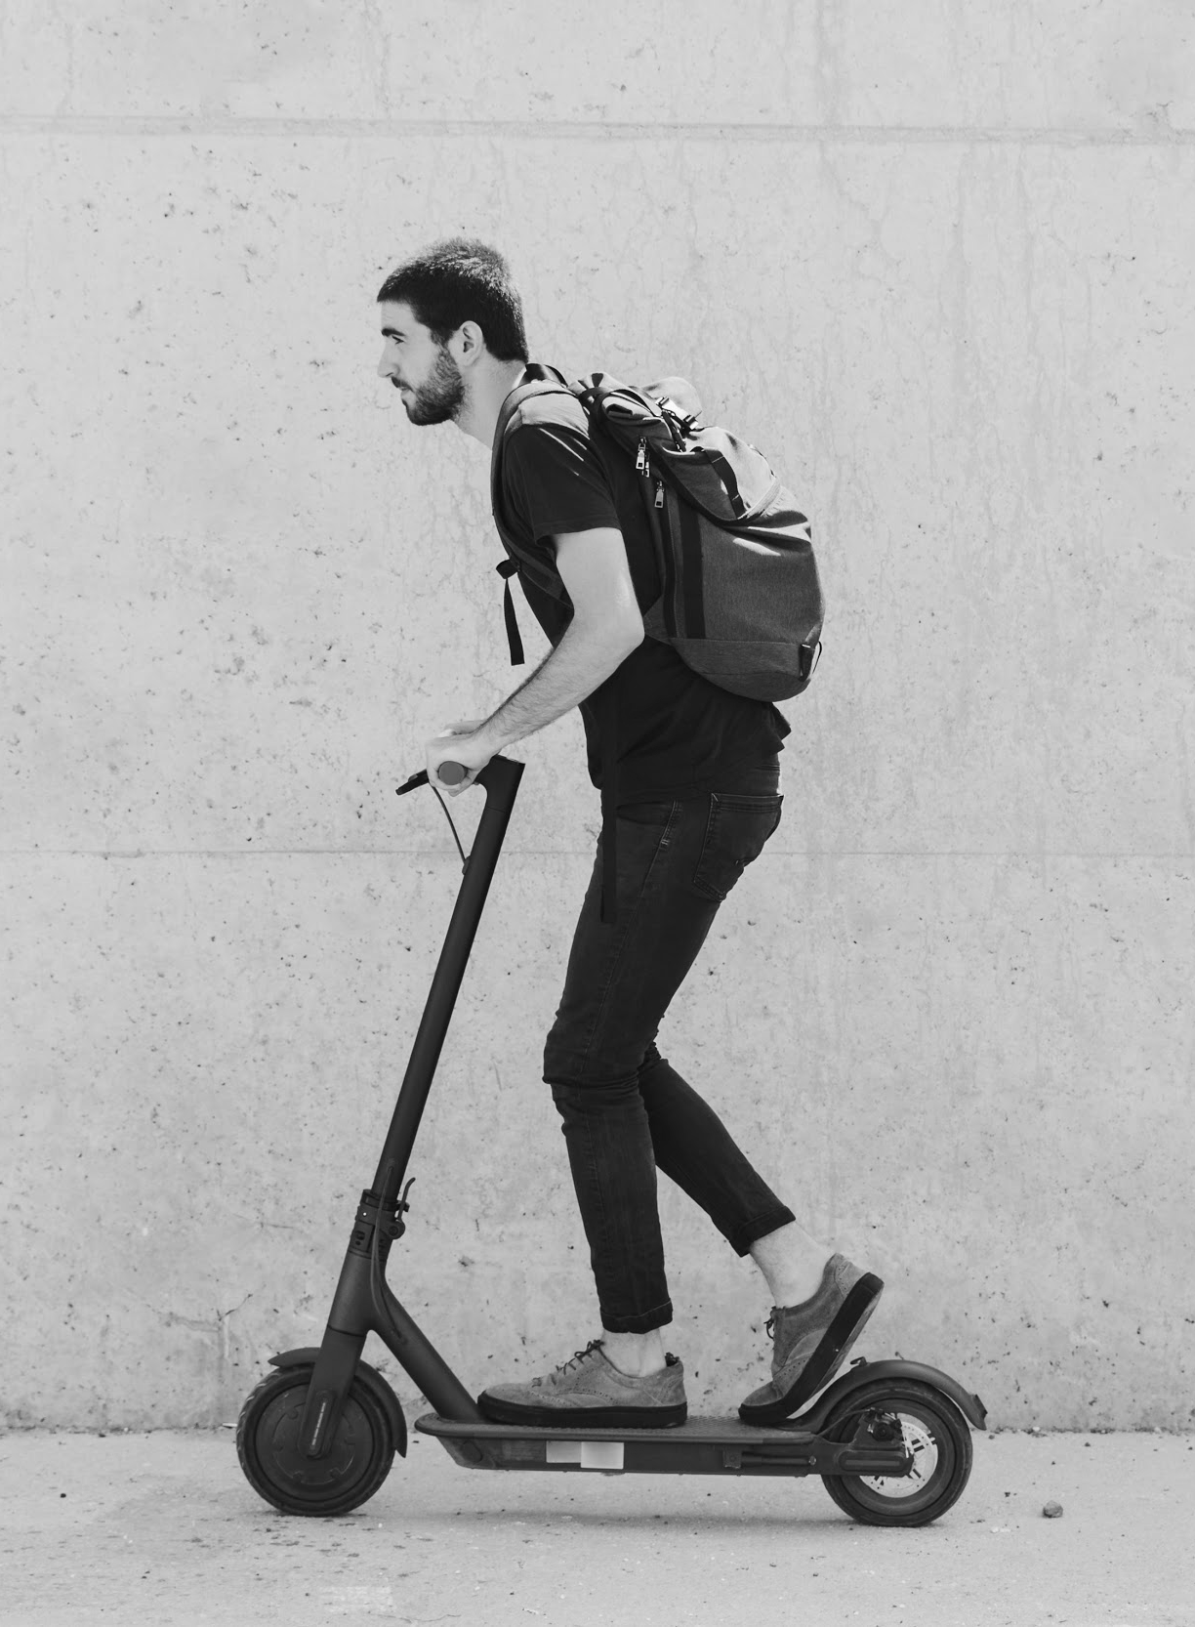
Ivysaur
Steve Lee – server-side, MongoDB, deployment, README update
Kobe Matias - UI/UX design and client-side, React
Jenny Yoon - presentation and client-side, HTML, CSS, JavaScript main, research
Erica Cannedy - producer, server-side, Authentication

Slide 3
Table of Contents
01
02
03
Elevator Pitch
Target Audience
What is Pocket Money?
04
05
06
Challenges/Success
Technologies
Future Development

Slide 4

01
Elevator Pitch

Slide 5

Elevator Pitch
Pocket Money helps estimate international travel costs. It helps the users estimate long-term travel costs based on the country of destination. Our app is concerned with the power of US dollar in a country. The purpose of the app is to lower the excess monetary preparation.

Slide 6
02
What is Pocket Money?

Slide 7
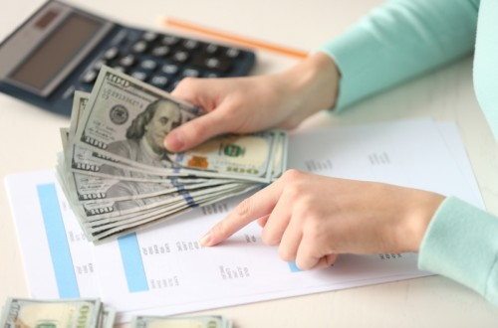

What is Pocket Money?
A budgeting app that Big-Mac Index to estimate the relative value of the budget.
For example, the items you expect to buy in USA for $1000 will not cost $1000 in another country.
In depth: Big-Mac Index is an index proposed by theEconomist for a measurement of Purchasing Power Parity (PPP). A random basket of goods in one country does not cost the same in another because the relative values of each currency differ. The feel of a dollar, or what $1 USD can achieve isn’t the same as what 1 KRW (Korean Won) can achieve.

Slide 8
03
Target Audience

Slide 9
Target Audience
Budget travel expense
Target
No calculator
Travel-related agencies who wish to provide an accurate budgeting service
No more sitting with a calculator trying to work out your budget for a trip
Save your Money! Don’t exchange or prepare excess amount of money!
Notes:
Travel-related agencies who wish to provide an accurate budgeting service

Slide 10
04
Challenges Success

Slide 11
Challenges
Firebase
React structuring
Success
Google login
CRUD with MongoDB
Developed stronger understanding of react
Facebook login
Custom login
Big Mac Index API
Material UI with react
MERN + Third-party API

Slide 12
05
Technologies

Slide 13




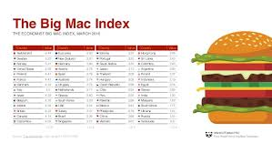
Technologies Used
MongoDB
mongoDB Atlas
React.js
Express.js
Node.js
Material UI
Heroku
Big Mac Index API
Firebase

Slide 14
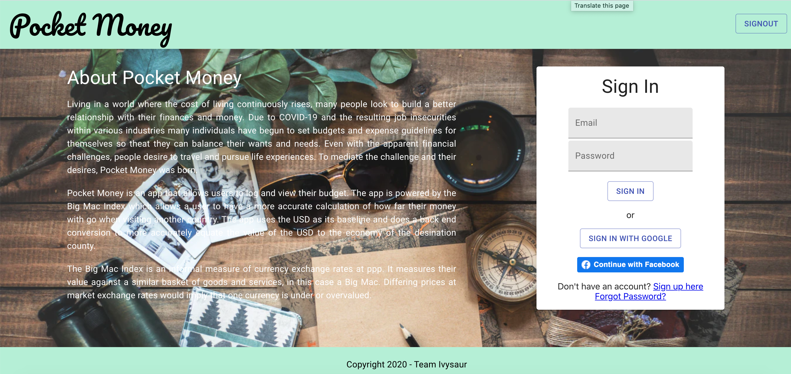
Demo

Slide 15
06
Future Development

Slide 16
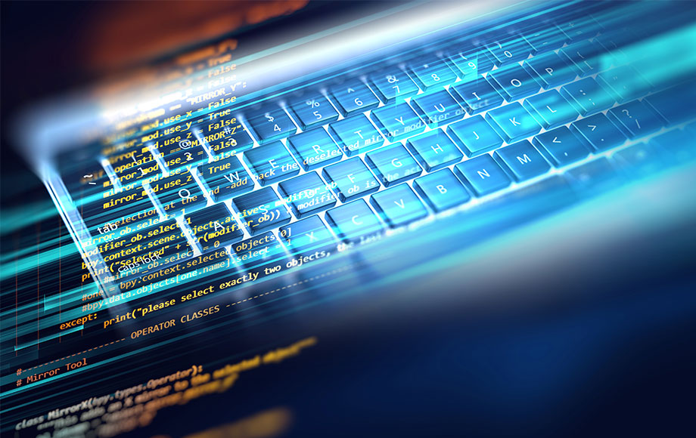
Future Development
Detailed budget listing
Facebook and other sign-in methods
FERN
Pie-chart

Slide 17

Thanks!
Do you have any questions?
ivysaru2020@ivysaur.com

